Slide 1




How to Win The Cloudforce-Microsoft Track
February 13, 2026

Slide 2

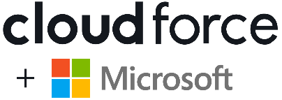


Track Summary
Best Use of PatriotAI
This track is intentionally open and flexible. There is no required problem domain, theme, or use case. Your goal is simple: show us how you used PatriotAI in a meaningful way as part of your hackathon project.
Whether you’re building an app, agent, workflow, analysis tool, or prototype, any idea is eligible as long as PatriotAI plays a clear role in how you built your solution.
Participation is straightforward:
✅ Use PatriotAI in your project
✅ Be prepared to explain how and why you used it
✅ Demonstrate the value it added to your solution
✅ Post how you used PatriotAI on LinkedIn
Notes:
- Creating an Azure-based chatbot solution to aid the admissions department
- The bot should be aware of current information
- ChatGPT3.5 was updated last in April 2023, so it may not know about current information. TEACH IT!
- YOU decide how to complete this task but we will give you some pieces to build upon and give you some assistance out of the gate to help guide you in the right direction.

Slide 3


Judging Criteria
1. Effective Use of PatriotAI
How clearly and thoughtfully was PatriotAI used?
Does it add real value beyond a basic or superficial use?
Can the team clearly explain why they used PatriotAI?
2. Impact & Usefulness
What problem does this solve, and for whom?
Does the solution address a real user need or opportunity?
Is the outcome easy to understand and communicate?
3. Feasibility & Execution
Can this realistically work?
Is the solution achievable within a hackathon setting?
Does the demo function as described?
Is the scope appropriate and well-executed?
4. Clarity of Demo & Explanation
Is the LinkedIn post informative?
How well is the project presented?
Is the workflow clear during the demo?
Is the story concise and compelling?

Slide 4


X
PatriotAI is nebulaONE

Slide 5
Microsoft Powered
GenAI, for all.
Cloudforce is pleased to present nebulaONE: an Azure-native generative AI platform strategically designed to make advanced AI services accessible to non-technical users across educational institutions and academic medical centers – aligning with Microsoft's commitment to empower education through technology.
Through a user-friendly interface that facilitates the utilization of generative AI, nebulaONE enables multi-modal conversations and no-code data-powered agents, all tailored to meet the diverse needs of higher education. By simplifying access to Microsoft’s most advanced AI capabilities, nebulaONE aims to democratize GenAI, for all.
nebulaONE® has earned a Microsoft Azure Certified Software Designation and is eligible to decrement MACC agreements.

Slide 6







THE
OPPORTUNITY
Prestigious universities are at a pivotal moment with generative AI, presenting a unique opportunity to redefine education and research. Forward-thinking institutions are leveraging GenAI to enhance learning experiences, streamline administrative processes, and foster cutting-edge research.
By integrating GenAI into their curricula and toolsets, universities can:
Offer personalized education tailored to individual student needs
(incl. tutor bots)
Improve engagement through interactive AI-powered tools
(incl. admissions bots)
Support faculty with advanced research capabilities
(incl. API access to LLMs)
Reduce administrative burden of repetitive tasks
(incl. document translation)
Ensure their graduates are equipped with the skills needed in a rapidly evolving technological landscape
Maintain their competitive edge, attract top talent, and continue their legacy of shaping future leaders and innovators
Notes:
Again, we do work very closely with a number of colleges and universities across the United States and Europe and see that we are a pivotal moment in time with a unique opportunity to redefine education and research.
There are a few areas where we saw commonalities amongst many of our customers, things like offering personalized education for students, using things like tutor bots.
Improving engagement with AI powered tools, so things like powering admissions through AI interfaces that would help students to answer their questions.
Supporting faculty with Advanced Research capabilities. Many of the universities that we work with have very large research organizations within them, and they're looking to leverage large corpus of data for all sorts of things within their research, often with sensitive or proprietary data sets. We also support researchers by allowing them to continue to work within their own chosen system and provide direct API access to LLMs.
Reducing administrative burden of repetitive tasks. So this is more sort of staff and faculty focused. What are the things that they're doing constantly every day that we can potentially automate or provide agents that could take some or all of the burden off of the staff member to do these repetitive tasks?
Ensuring graduates are equipped with skills they need. This is becoming more and more of an ask from the students themselves wanting to understand how their university is integrating Gen. AI into their curriculum and into their experience as students. I think most of us recognize that in the working world, we’ll be expected to have not only familiarity, but proficiency with these tools. And so the earlier that they can get meaningfully engaged with them, the better.
And then lastly, how does the university itself maintain its own competitive advantage and attract really top talent with a number of universities now making a fairly big splash with their own Geni platforms and their own Geni strategies? It's becoming more and more of a necessity that every university have a really public face and well thought out Geni strategy.

Slide 7


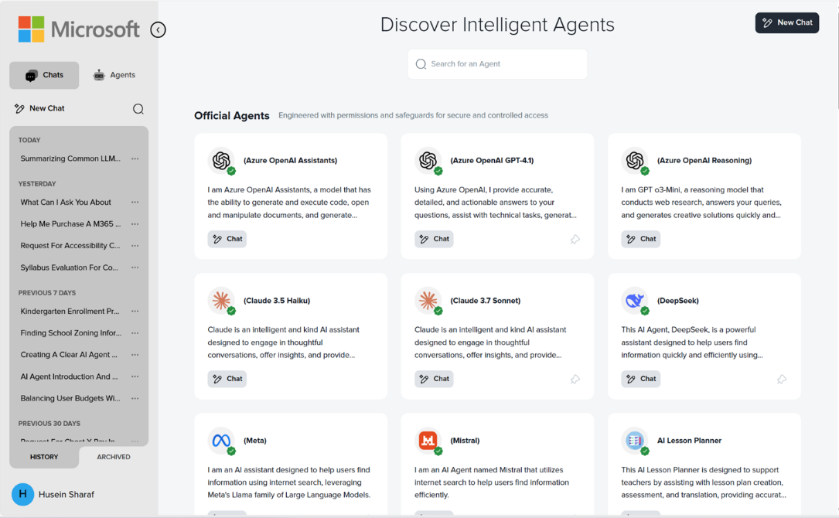



Your “AI Gateway” for All
Every Model, in One Place
All the latest GPT models from OpenAI, plus Claude, Llama, Mistral, Grok, DeepSeek, and more – priced on consumption, not per user
No Code, No Fuss
Fully-automated one-time deployment by our experts, automatically updating its features, models, and infrastructure
Secure & Compliant
Deployed privately within your own Azure tenant, providing enterprise-grade security, compliance, and governance
Familiar, Yet Custom
A familiar “ChatGPT-style” experience, with a simple and intuitive user interface, designed to look & feel like your brand
Notes:
With other platforms, you're pretty much stuck with their models. However, with n1ai, you can ostensibly pull in any model that Microsoft makes available through the models of the service API. So we have access to all of the models in the Azure catalog as well as Anthropic’s Claude models. Very soon we will have the Gemini models available as well. So you have the flexibility to really pull in any model for different use cases and you can mix and match models for different purposes.
The cost of nebulaONE is entirely driven by the token consumption of the tool and the underlying infrastructure. So, there is no per user per month licensing fee, which means that you could provide access to every user on campus and users who don’t log in would cost you nothing.
It’s worth noting that there were some initial concerns from customers about a consumption based tool. We heard those concerns and have actually built in the ability to limit token consumption by user per month or per agent per month. This way you’re able to control costs and stay within your predetermined budget.
nebulaONE deploys and orchestrates all of the infrastructure and models required for you, which means that you don't necessarily need a team of Azure engineers and developers to deploy models or build AI agents.
It's deployed completely privately within each university's own Azure tenant. So this means that we don't actually have any access to the data or the information that's shared with it. Some of the things that we like to point out is that because it lives within your environment, you can actually work with private and sensitive information- because it sits behind your existing compliance boundary. All of the underlying services that run the application are already HIPAA compliant from Microsoft, and we’ve gone through the process of having the application layer audited for HIPAA and Soc2 compliance.
It’s completely self isolated in your own Azure tenant and it's also grounded in your unique data sets. So if you have data in Azure that you want to bring in to a conversation, it's easy to do that as well as now we're bringing in data from other data sources.
For the end user, it does look and feel a lot like a ChatGPT enterprise experience. That was intentional because we wanted to make it simple for people to pick up and use. At this point most have used ChatGPT and so there is a familiarity with that UI.

Slide 8
X
Not a GMU student? No problem.
During this seminar, RIGHT NOW, we will build a publicly available PatriotAI agent that any participant can use during the hackathon—making this track accessible to everyone.

Slide 9
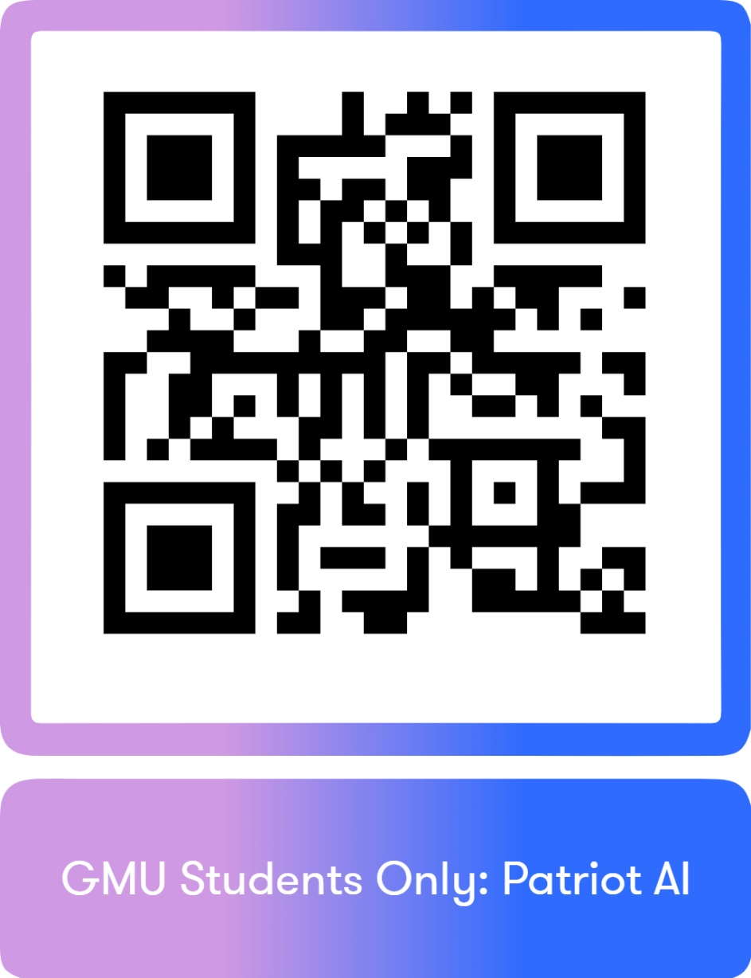
PatriotAI GMU
Student
Access

Slide 10
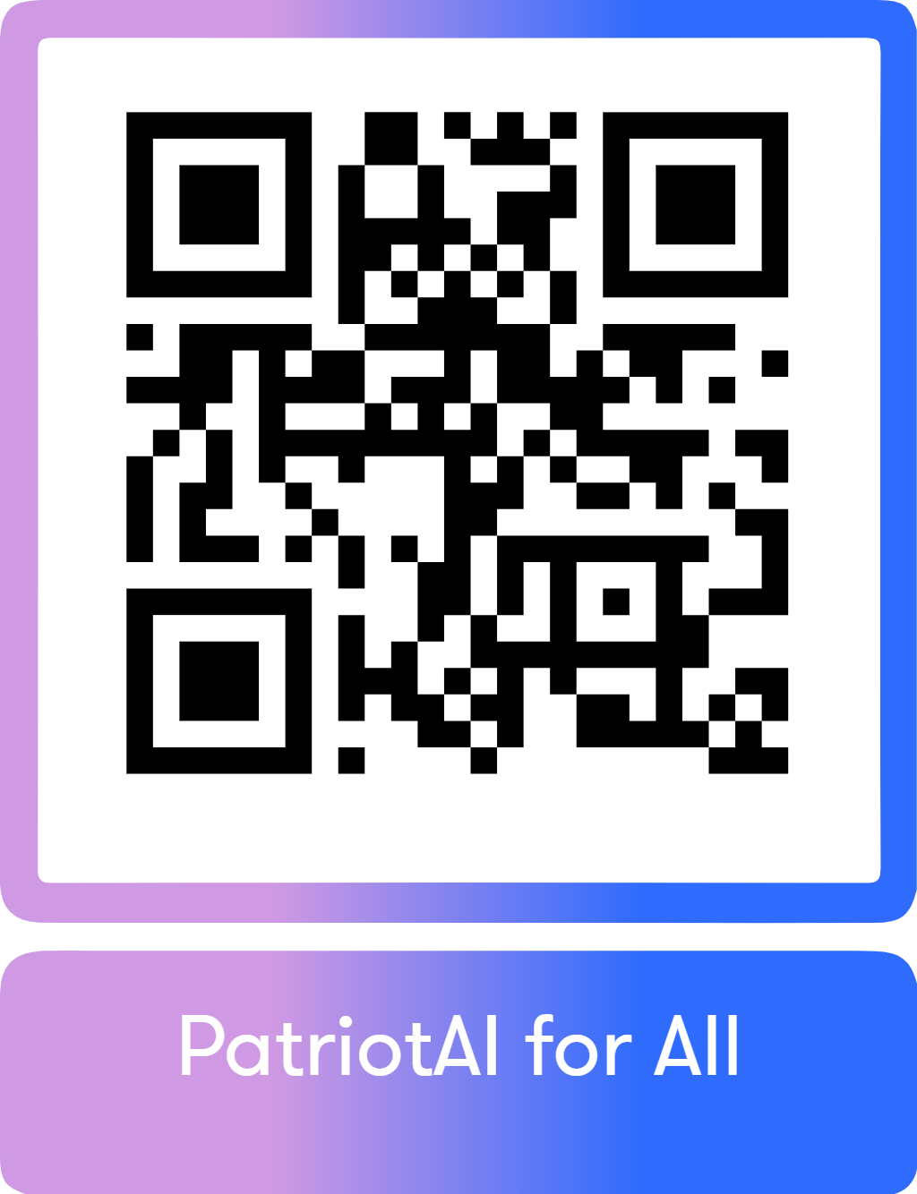
PatriotAI for All

Slide 11
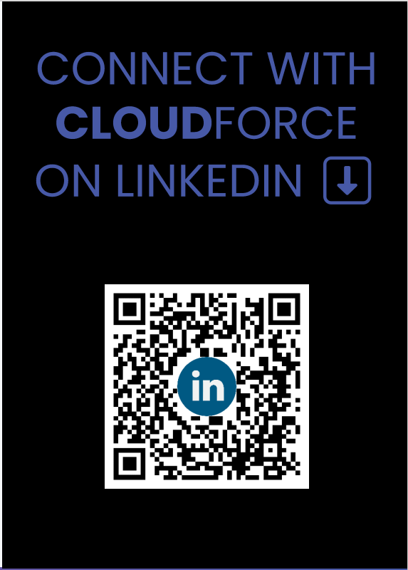
Thank You!

